Slide 1
From Dafny to RTL
Refactor for HLS
fixed-size types + remove runtime functions
Dafny
requires/ensures verified
Dafny → C++
top.cpp + runtime
Verilog RTL
FSM + MUX + comparator logic
Vitis HLS
C synthesis → reports

Slide 2
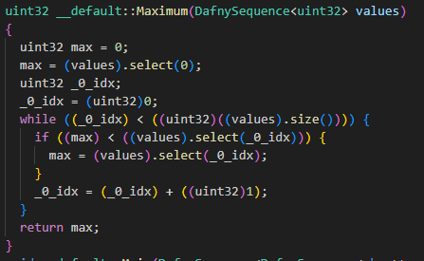
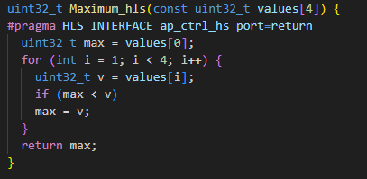
Abstraction to Hardware

Slide 3
HLS Synthesis Results
Normal:
UNROLL:
Metric | Value
Latency | 9 cycles (90 ns)
Interval | 10 cycles
Slack | 3.02 ns
LUT | 185 (2%)
FF | 109 (~0%)
DSP | 0
BRAM | 0
Metric | Value
Latency | 1 cycles (10ns)
Interval | 2 cycles
Slack | 2.70 ns
LUT | 585 (7.3%)
FF | 286 (1.8%)
DSP | 0
BRAM | 0

Slide 4
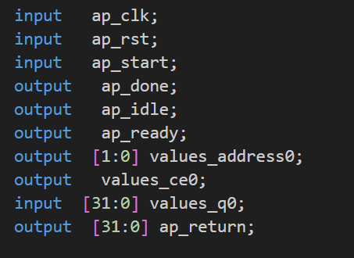
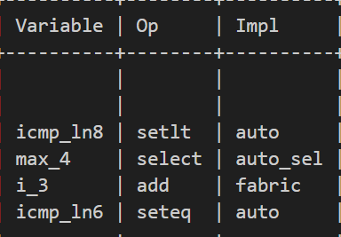
RTL Analysis
Control Path：
ap_start: trigger one transaction
ap_done: asserts when complete
ap_idle: high when waiting start
ap_ready: indicates readiness for next
setlt → comparator (max < v)
select → mux (choose larger value)
add → loop counter increment
2 Small State Machine
1 Comparator 1 Mux 1 Adder

Slide 5
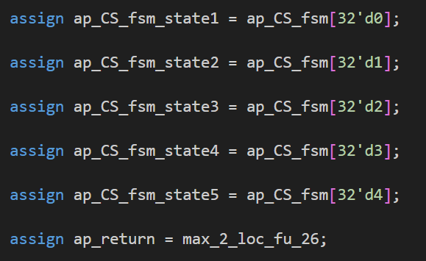
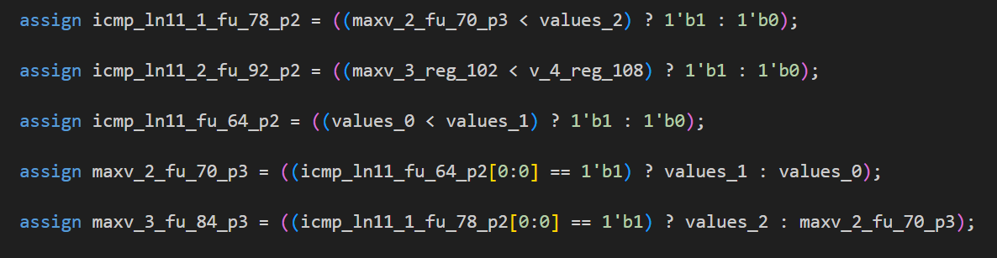
Sequential Compare-and-Update Logic：
“#pragma HLS UNROLL” Version: (AI Recommend) :
Normal Version:
Single comparator reused
Mux-based value selection
Max stored in register
Loop controlled by scheduler
The absence of unrolling results in a time-multiplexed datapath rather than a spatially expanded comparator network.

